Slide 1
Graphs
Show what your research project found out

Slide 2
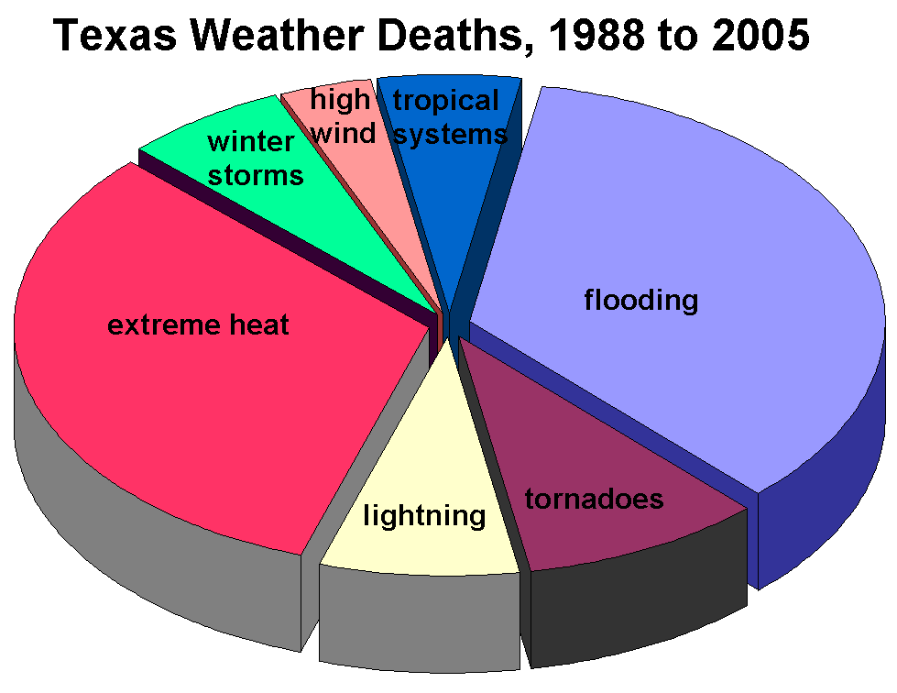
Notes:
http://www.crh.noaa.gov/Image/lub/safety/swaw/

Slide 3
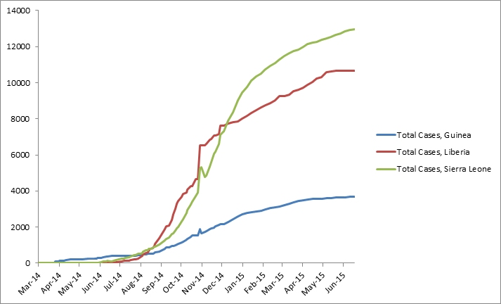
Graph 1: Total suspected, probable, and confirmed cases of Ebola virus disease in Guinea, Liberia, and Sierra Leone, March 25, 2014 – June 14, 2015, by date of WHO Situation Report, n=27305
Notes:
http://www.cdc.gov/vhf/ebola/outbreaks/2014-west-africa/cumulative-cases-graphs.html

Slide 4
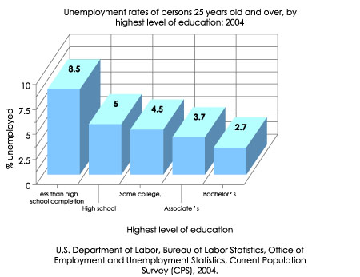
Notes:
https://nces.ed.gov/nceskids/help/user_guide/graph/bar.asp

Slide 5
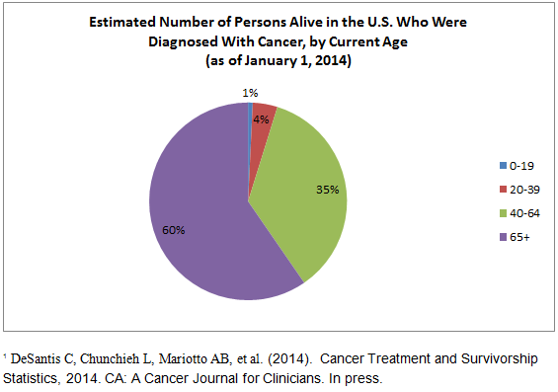
Notes:
http://cancercontrol.cancer.gov/ocs/statistics/graphs.html

Slide 6
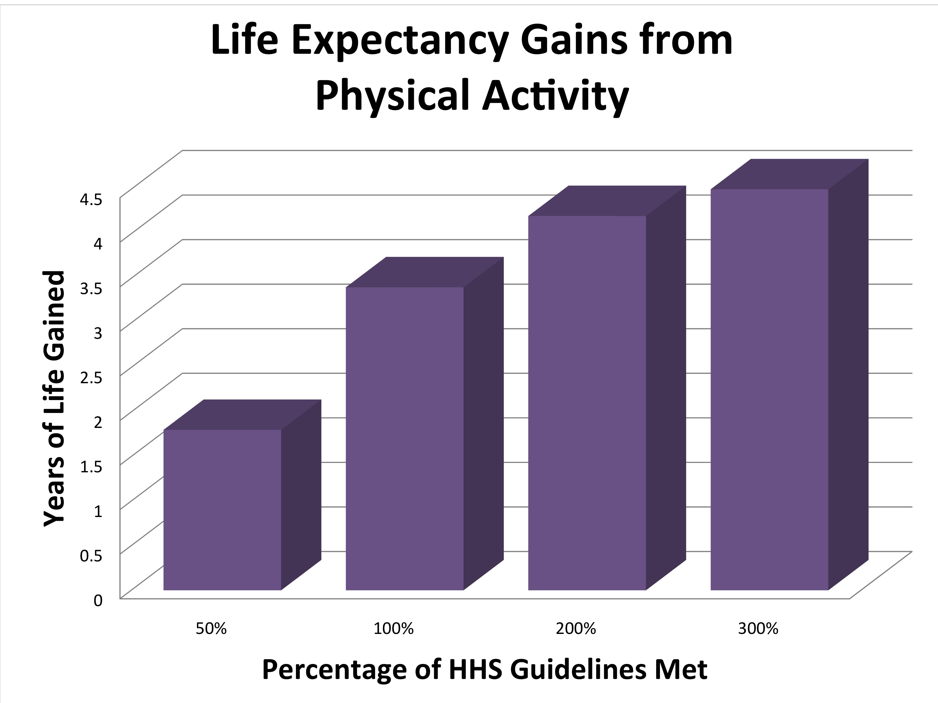
Notes:
http://www.cancer.gov/news-events/press-releases/2012/PhysicalActivityLifeExpectancy

